Slide 1
SSIE 637
Advanced Topics in Healthcare
Lecture #2

Slide 2
Before the class
Python tutorial
From installation to basic data process → Next class
Reference paper
Making a list but you can access the journal using BU system
Using google scholar!! You can download the paper if you connect the internet on the campus
For remote student, using library system
Email
Please add [SSIE637] and name at the title of email for easy configuration

Slide 3
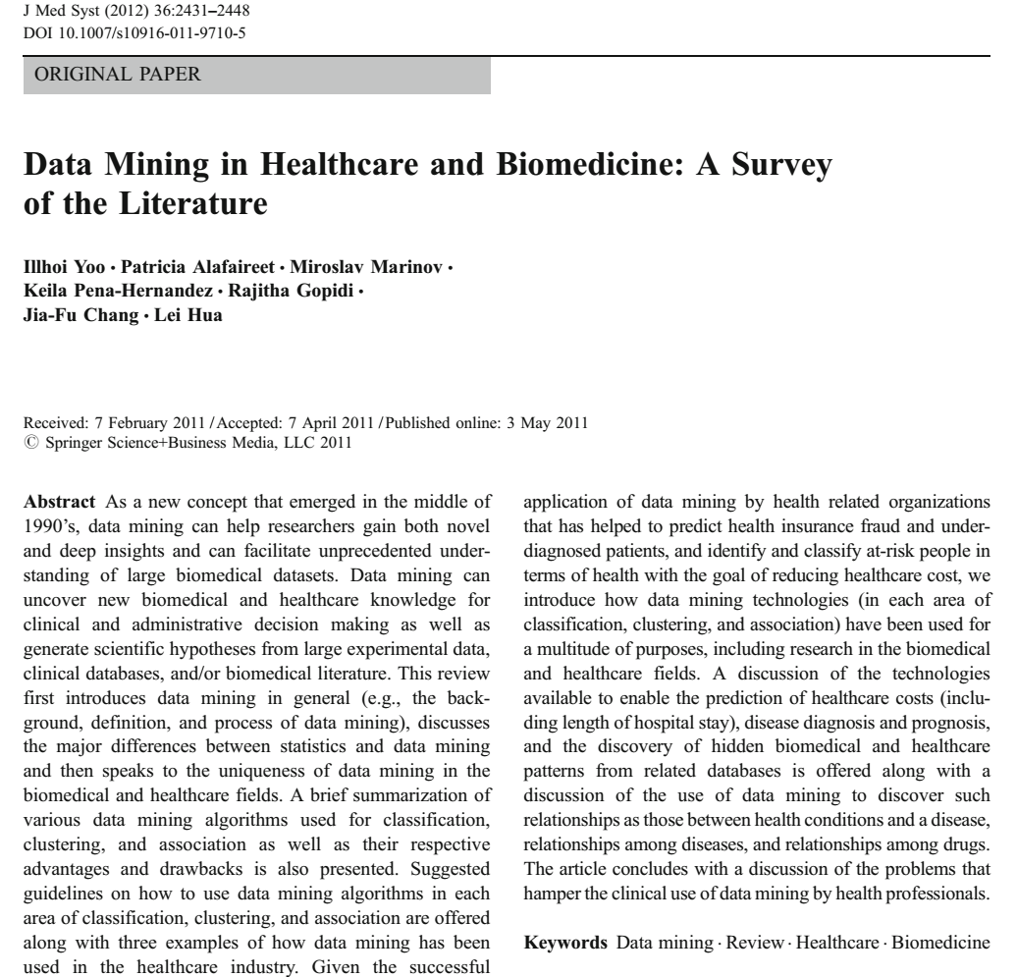
Brief survey of data mining techniques
Application to healthcare organization
Fraud detection
Identification and classification at-risk people

Slide 4
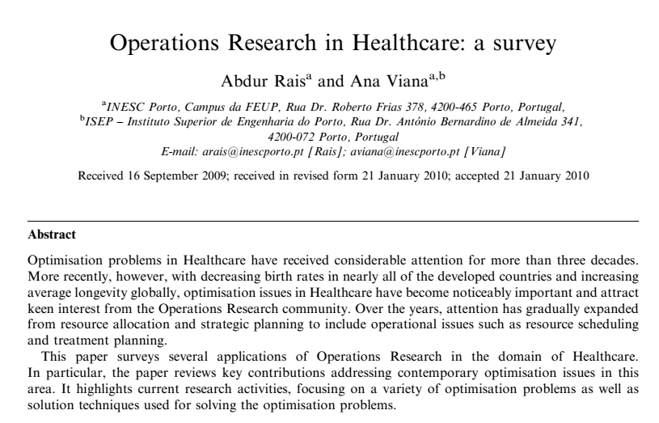
Brief survey of OR techniques
Queueing model, simulation, math. Opt.
Forecasting demand
Allocation
Capacity planning / scheduling

Slide 5
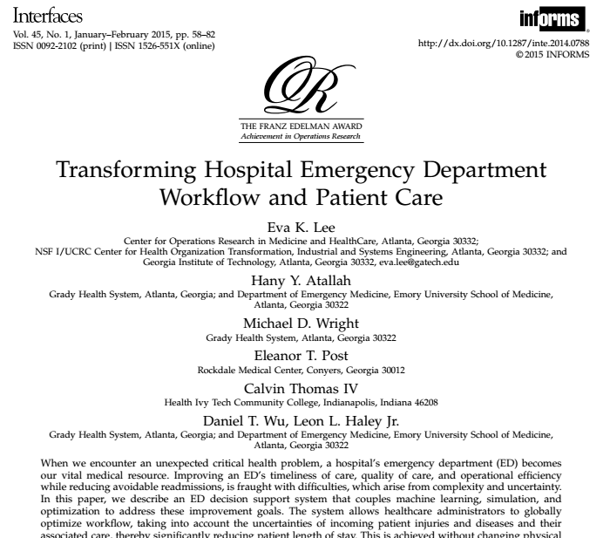
System optimization for emergency department
Decision support system: machine learning + simulation+ opt.
Aid system manager to optimize overall workflow
Reduce waiting time for patients

Slide 6
Decision making and planning in Healthcare
How to provide good services in healthcare is still important!
Forecasting
How to forecast patients flows and demand?
Prediction
Detect disease accurately
Human resource allocation / scheduling
Nursing schedule : How to schedule nurses with satisfying their predetermined day-off? How to set a schedule to maintain an adequate service level?
Logistics
Determining locations of medical centers (clinics) and scheduling emergency vehicles for providing maximum coverage
Selection of hospital locations for covering population
Capacity management and location selection for health service
Inventory control for health materials
Treatment
How should set the plans of radiation therapy for minimizing the treatment time
Such problems can be solved and analyzed by ISE knowledge (system opt, data analysis, simulation…)

Slide 7

OR techniques (modeling + high computation) for real-time treatment
Decision seed points of radioactive
Cost effective decision making -> less radiation time + needles

Slide 8
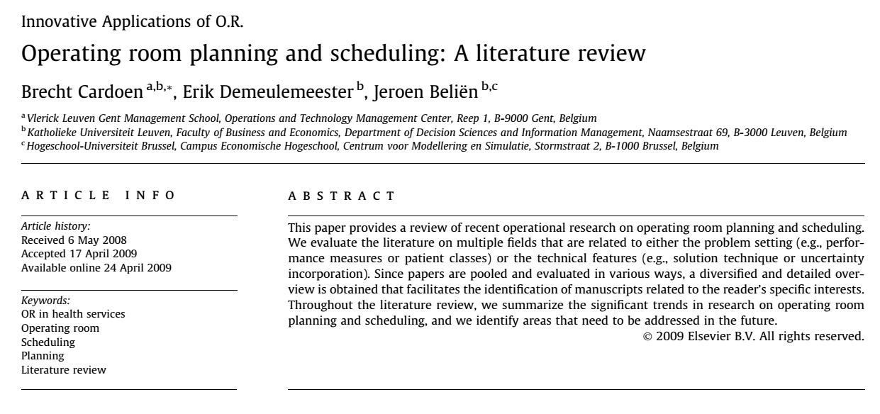
OR in operating room planning / scheduling
Survey paper

Slide 9
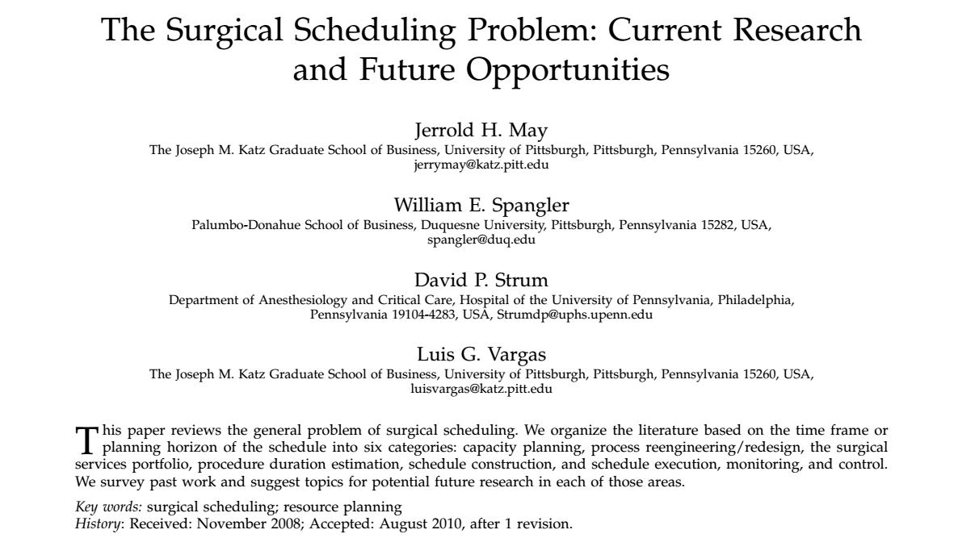

Slide 10
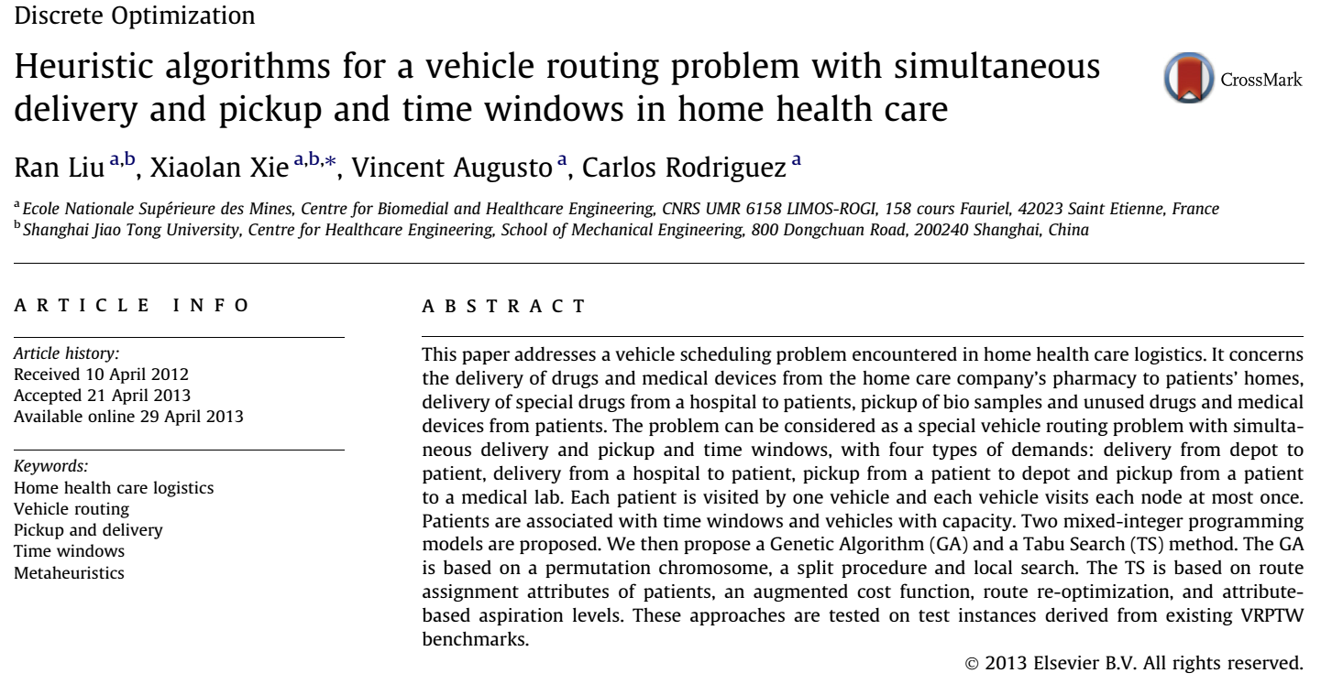
Vehicle routing problem→ drugs/patient delivery vehicles scheduling
Mathematical modeling
Meta-heuristics algorithms

Slide 11
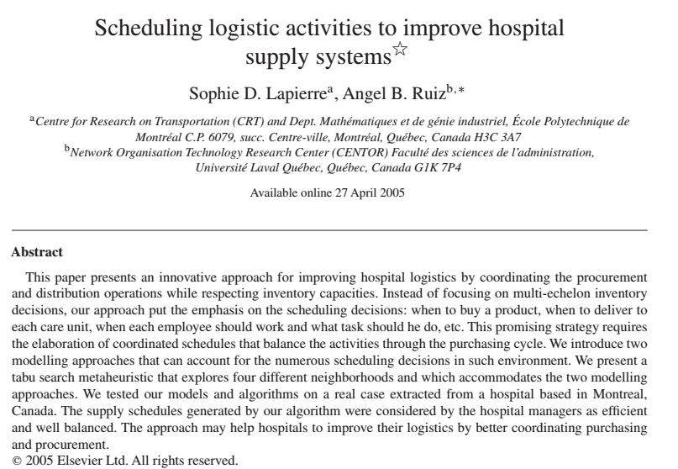
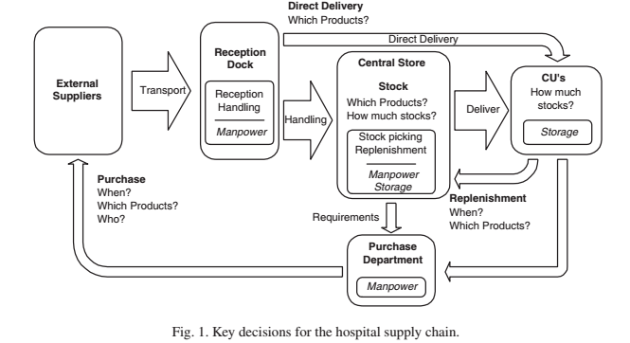
Decision making for inventory planning for hospitals
Coordinate schedules : balancing the activity with purchasing
Mathematical modeling
Meta-heuristic

Slide 12
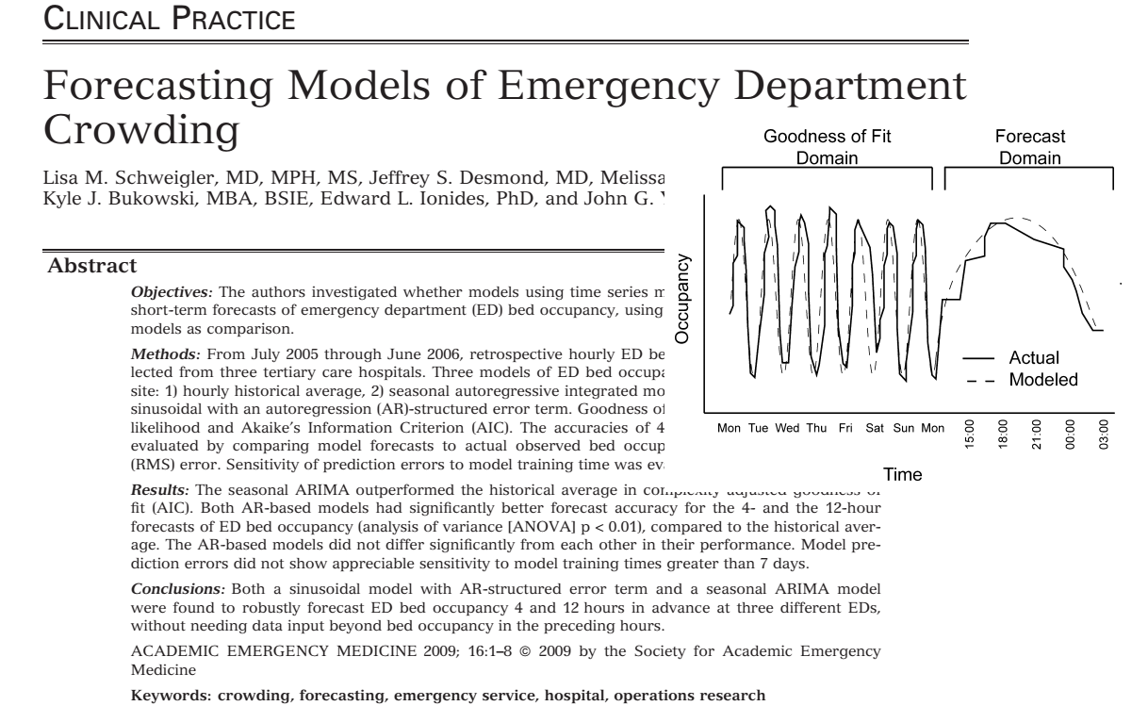
Patients forecasting for emergency department
Historical average
ARIMA
Sinusoidal

Slide 13
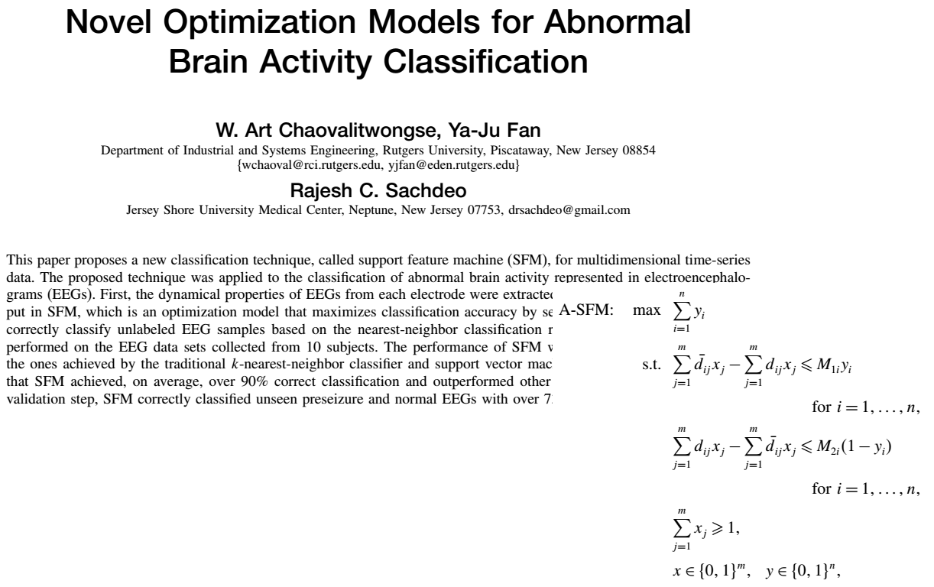

Slide 14
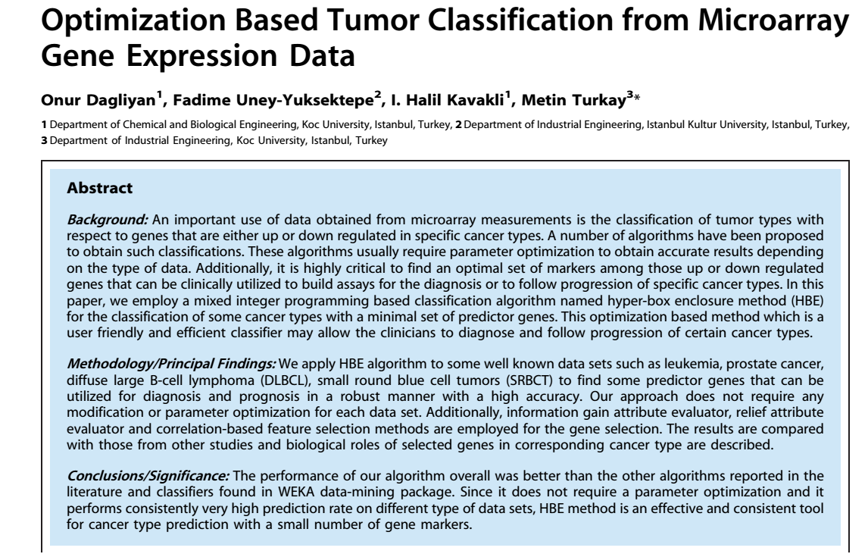
Classification of genetic data from tumor
Use hyper-box enclosure method
Combining with mixed integer programming
Totally unimodular property

Slide 15
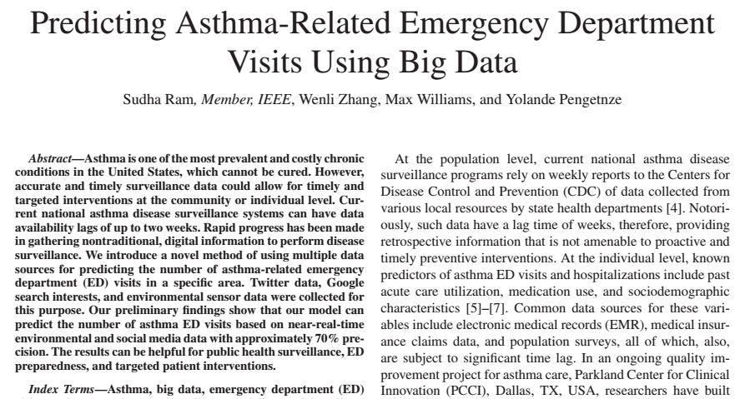
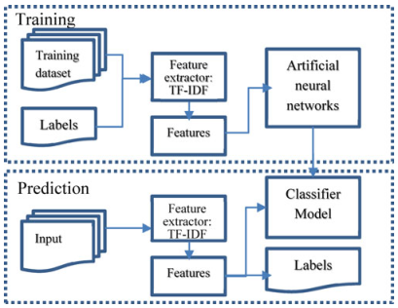
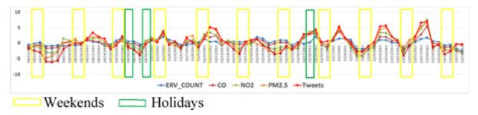
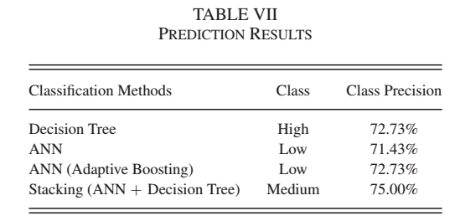

Slide 16
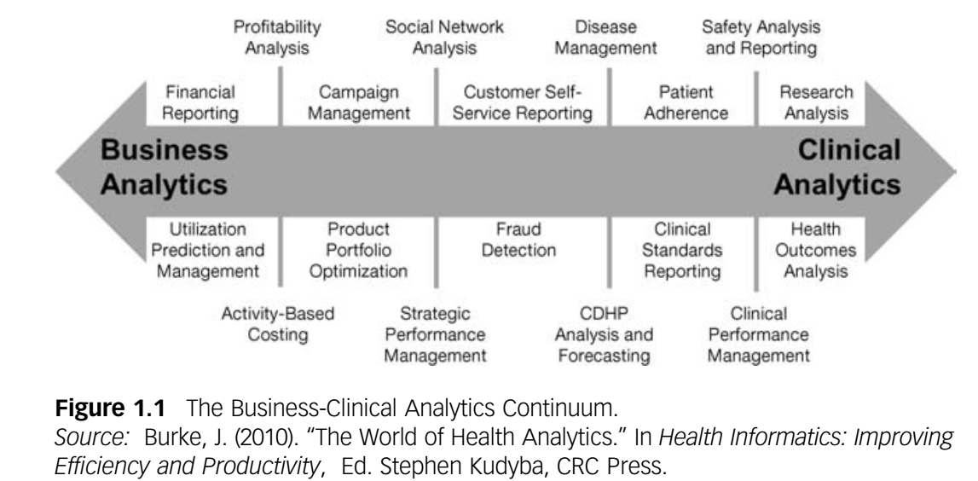
Health Analytics
Big picture of health analytics

Slide 17
Healthcare Transformation
Clinical / Health outcome | Maximizing the use of existing treatment and therapies
Research / Development | Discovering, researching and developing novel treatments
Commercialization | Maximizing sales, marketing, and customer relationship efforts
Finance and Fraud | Ensuring the financial health and stability of organization
Business operation | Driving productivity, profitability, and compliance across the various business functions

Slide 18
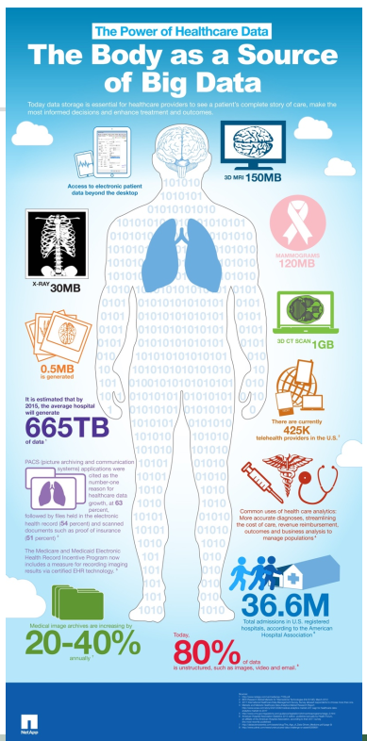
Healthcare Data
Challenges
Volume | Clinical documentation, Medical images, Sensors/monitors, genomics
Variety | Unstructured, audio/dictation, clinical narratives, images/video
Velocity | Predictive models, risk models, point-of-care OR,ED, Decision support, Real-time results
Value | Aggregated clinical data, cost containment, decision support, care quality, safety
IDC health insights, 2015

Slide 19
Healthcare Data Analytics
4 key foundations
Information management | Aggregation, standardization, restructure , and preparing the rising quantities of data
Statistic | Mathematical principles to available data in order to describe the past, understand the present and predict the future
Information Delivery | Making analytical results and SW assets available to individual who is responsible for decision making and actions taking
Computing | Reducing the time delay required to conduct analyses and surface information by leveraging advanced technology

Slide 20
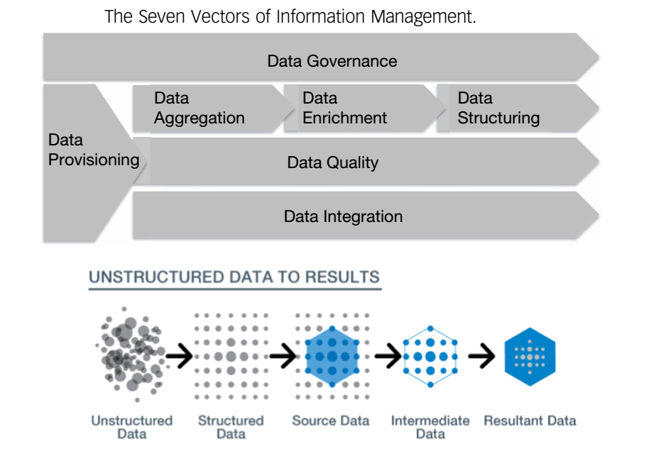
Healthcare Data Analytics – Information management

Slide 21
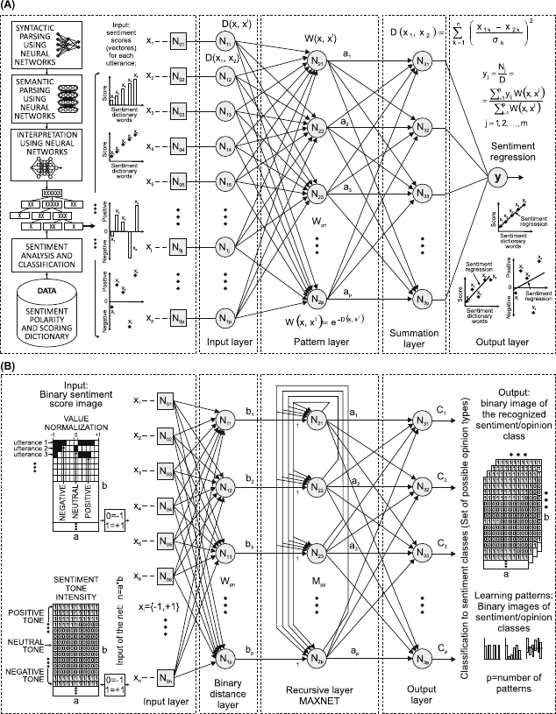
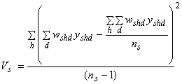
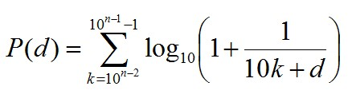
Healthcare Data Analytics – Statistics
Key component of the scientific method
Inferential statistics are crucial to drawing conclusion from medical research
Forecasting. Ex) models a pattern in observable data to predict likely future outcomes
Data mining allows us to detect, measure, and model consumer sentiment in media
Statistical modeling allows us to detect prevent claims fraud

Slide 22
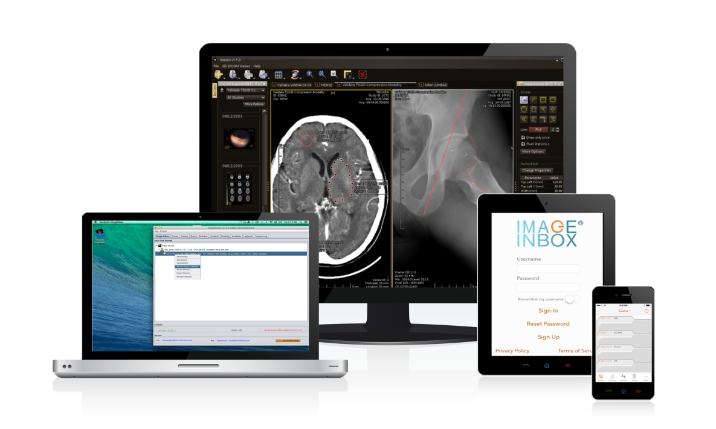
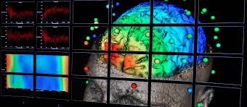
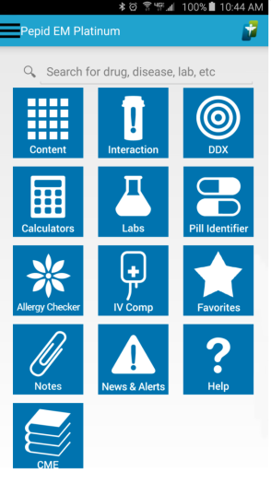
Healthcare Data Analytics – Information delivery
Offer no value if people cannot fit the analytics into their personal lives
information management and statistics are responsible for unlocking 3 activities
Viewing the results of analytical scenario
Manipulating analytical models to gain addition info.
Taking actions and making decisions based on analytical insight.
Information delivery paradigms are important to building an analytically driven healthcare enterprise

Slide 23
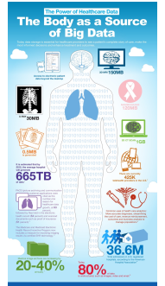
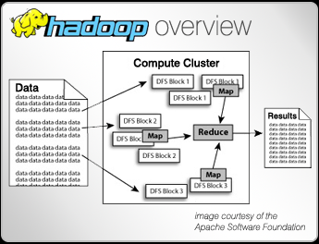
Healthcare Data Analytics – Computing
Volume and complexity both carry performance demands on an IT resources
3 ways to manage
Scale up: including more CPU, memory, devices, storage
Scale out: Hadoop, map-reduce
Scale in: In data base computation

Slide 24
Data Mining and Data Analysis

Slide 25
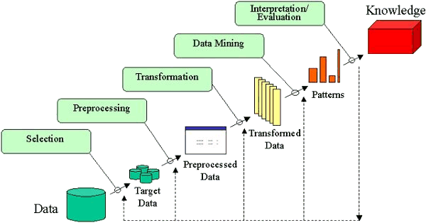
Data Mining And Analysis
Data mining is the process of discovering insightful, interesting, and novel patterns as well as descriptive, understandable, and predictive models from large-scale data

Slide 26
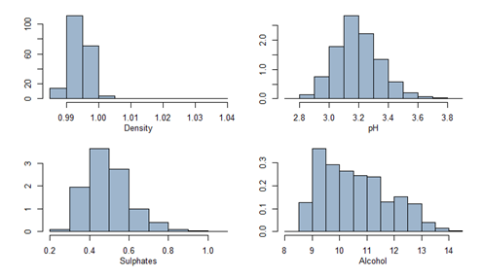
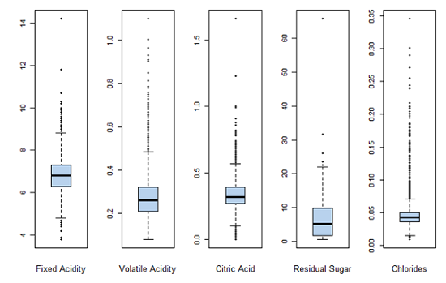
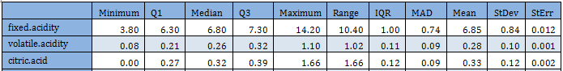
Main Tasks in Data Mining
Exploratory Data Analysis
Exploratory data analysis (EDA) is an approach to analyzing data to summarize their characteristics.
A statistical model can be used primarily EDA is for seeing what the data can tell us beyond the formal modeling or hypothesis testing task. needed.

Slide 27
Main Tasks in Data Mining
Frequent Pattern Mining
Finding relationships (regularities) among the items in a data. The problem can be stated as follows.
Given a data D with transactions T_1 ...T_N , determine all patterns P that are present in at least a fraction s of the transactions.
EX) what products were often purchased together?, what are the subsequent purchases after buying a desktop PC?
Customer | Juice | Cookie | Jam | Wine | Pattern
1 | ✓ | ✓ | - | - | [juice, cookie], 1
2 | - | - | ✓ | - | [jam], 1
3 | - | - | - | ✓ | [wine], 1
4 | ✓ | ✓ | ✓ | - | [juice, cookie, jam], 1
5 | ✓ | ✓ | - | ✓ | [juice, cookie, wine],1
6 | ✓ | ✓ | - | - | [juice, cookie],1
Juice and cookies together
=66%(support)
If you buy a cookie,
you also buy a jam
=25% (confidence)

Slide 28
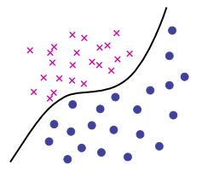
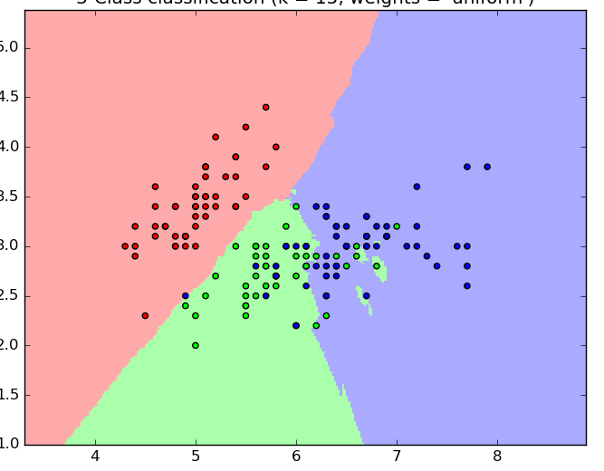
Main Tasks in Data Mining
Classification
Identifying to which of a set of categories (class) a new observation ( future) belongs.
Identification rule is determined by given training set
Ex) Suppose you have a data containing healthy & sick patients → identifying a rule, discriminating function ( = classifier) → predict a status of unseen (future) person
Healthy?
Healthy
Sick

Slide 29
Main Tasks in Data Mining
Clustering
It is the process of making a group of abstract objects into classes of similar objects.
Weight
Compared to the classification:
Find “natural” grouping of samples given un-labeled data whereas the classification learns a method for predicting samples from pre-labeled data
Height

Slide 30
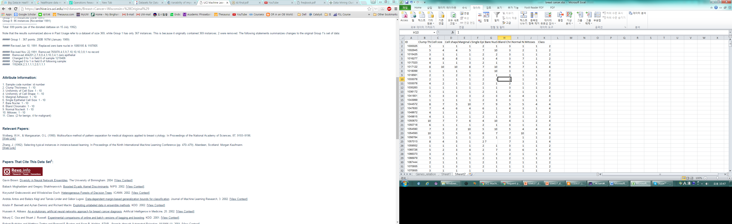
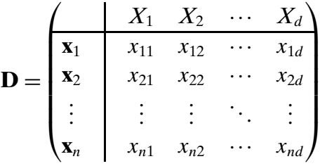
Data Representation

Slide 31
Data Representation: Feature
Features ( attributes) are used to describe / represent the characteristic of samples. It may be classified into two types:
Numerical Feature
A numeric feature is one that has a real / integer valued domain
Future classified into two types:
Interval-scaled / ratio scaled
Categorical Feature
A categorical feature is on that has a set-valued domain
Nominal vs Ordinal
Nominal : feature values are unordered, and thus only equality comparisons are effective
Ordinal : ordered. Equality / inequality comparisons are allowed.
Ex) Language, level, degree of dangerous

Slide 32
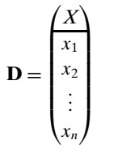
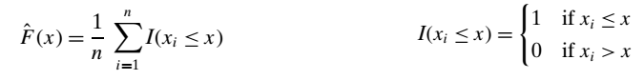
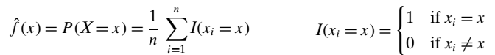
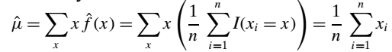
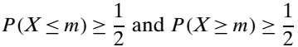
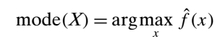
Exploratory Data Analysis
Univariate analysis → Single feature at a time
Cumulative Distribution Function (CDF)
Probability Mass Function (PMF)
Central Tendency
Mean
Median
Mode

Slide 33
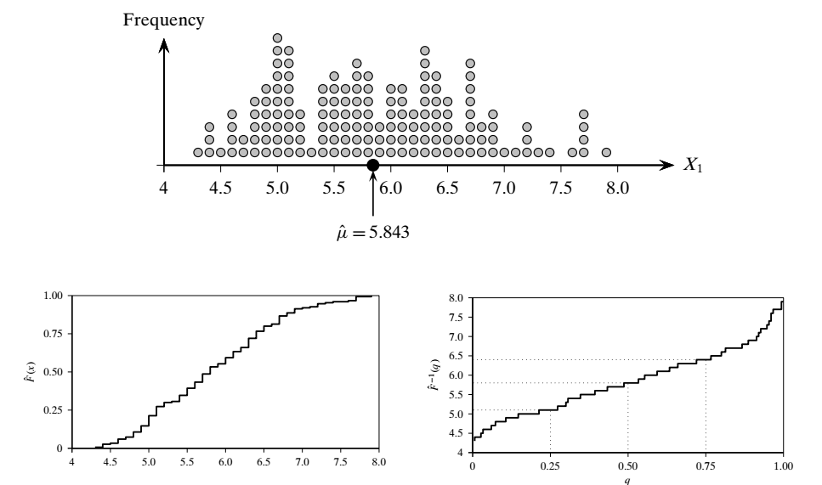
Exploratory Data Analysis (Univariate)
Example

Slide 34
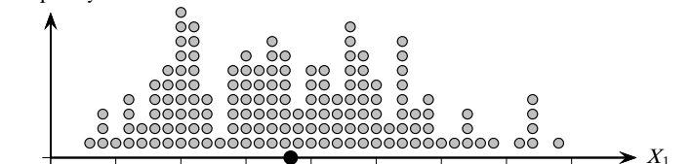
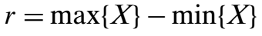
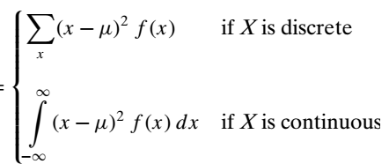
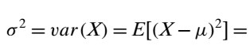
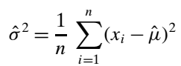
Exploratory Data Analysis (Univariate)
Measure of Dispersion
Range
Interquartile Range
Variance and Standard Deviation
Variance
Sample Variance

Slide 35
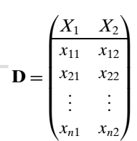
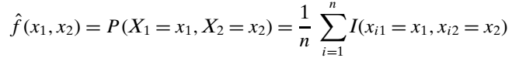
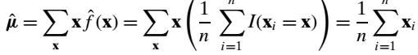
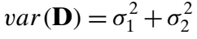


Exploratory Data Analysis (Bivariate)
Bivariate analysis is to consider two features at the same time
Joint Probability Mass Function
Measures of Location and Dispersion
Mean
Var
Covariance

Slide 36

Exploratory Data Analysis (Bivariate)
Correlation

Slide 37






Exploratory Data Analysis (Multivariate)
Multivariate analysis is to consider multiple features at the same time: $X_{1,…, }X_{d}$
Mean = $μ∈ℝ^{1×d}=E[X]$
Covariance = $Θ∈ℝ^{d×d}=$

Slide 38




Exploratory Data Analysis (Normalization)
Range Normalization
Standard score normalization
Zero mean and unit variance

Slide 39


Practice in Python
Recommend 2 packages
Pandas (http://pandas.pydata.org/) : Time series analysis, visualization
Scikit-learn (http://scikit-learn.org/): Data mining / Machine learning
Once you install Python, install two packages
Import pandas as pd
data = pd.read_csv(‘diabetes.csv’)
data.describe()

Slide 40



Practice in Python
hist(data['AGE'])
Data.boxplot()
scatter_matrix(data[[‘AGE’,’BMI’]])

Slide 41
References
Health Analytics: Gaining the Insights to Transform Healthcare (2013), Jason Burke, Wiley
Data Mining and Analysis: Fundamental Concepts and Algorithm (2015), Mohammed J.Zaki & Wagner Meira Jr.
http://www.learnpython.org/

Slide 42
Questions?

